Slide 1
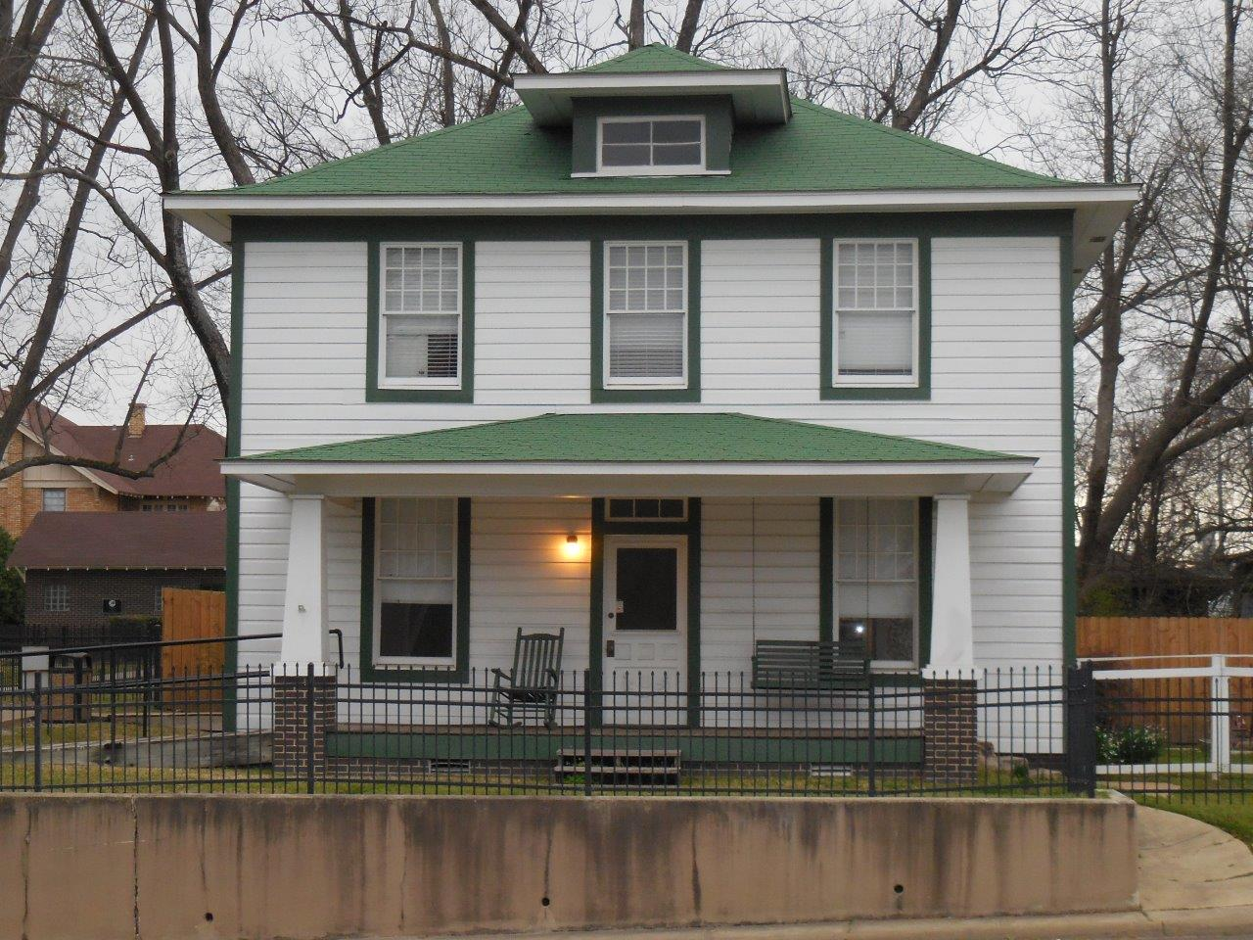


Notes:
The house on Hervey where it all began.

Slide 2
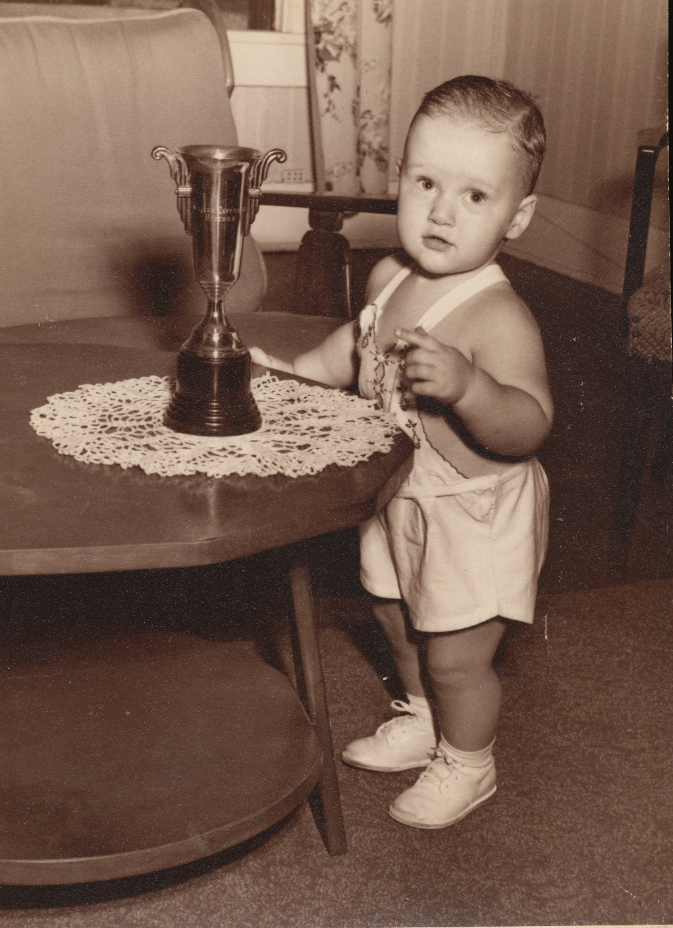
Notes:
The winner of the “pretty baby” contest at one year old

Slide 3
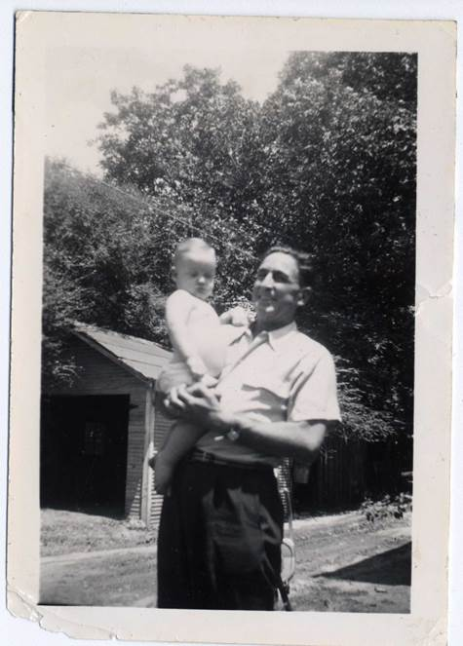
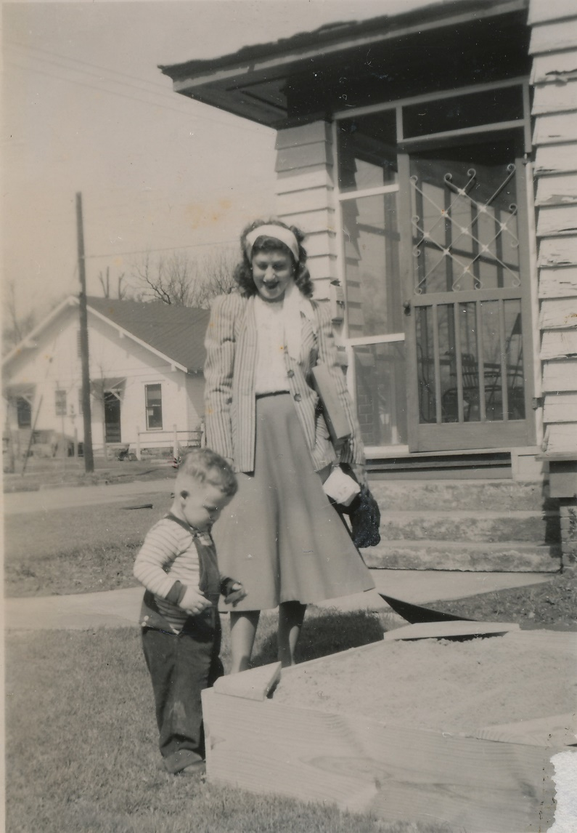
Notes:
With grandfather, mother and grandmother

Slide 4
Notes:
Clinton in pre-school on the far left

Slide 5
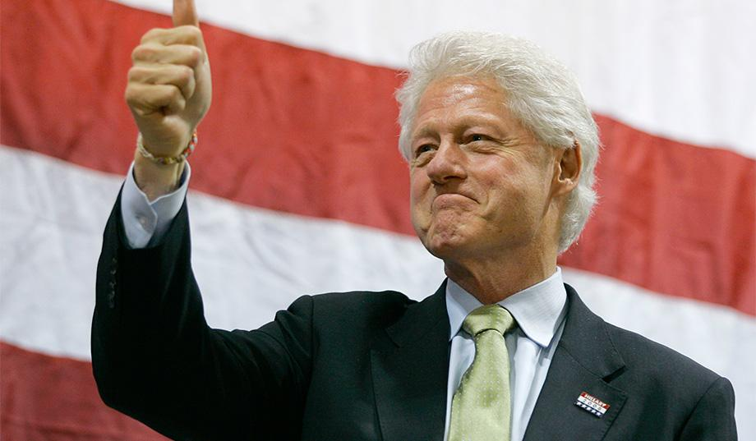
Notes:
How the circumstances surrounding his upbringing prepared and propelled him to the top office in the country

